Slide 1
Hospital Dashboards Overview USING GRAFANA
Purpose: Present three dashboards offering real-time and comparative hospital metrics.
Key Metrics: Admissions, Discharges, Deceased, Transferred, Emergency, Length of Stay, etc.
Tool: Grafana, connected to PostgreSQL.

Slide 2
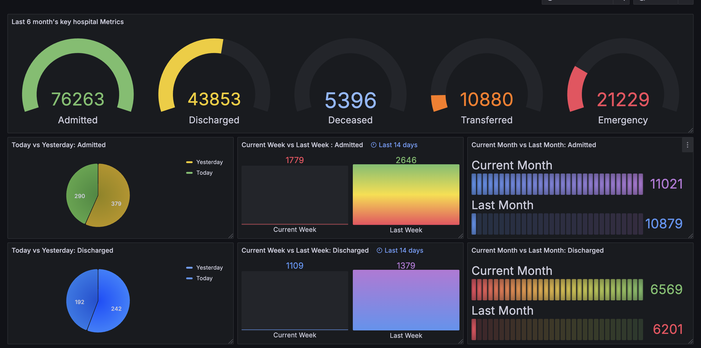
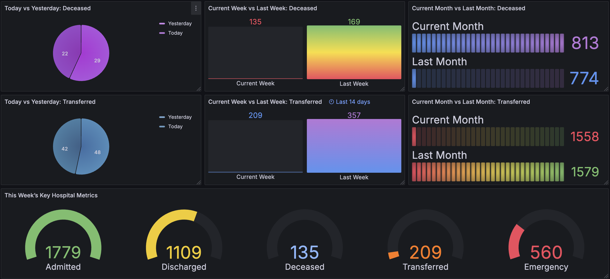
Dashboard 1 – Key Metrics & Comparisons
Notes:
Purpose: Show daily, weekly, and monthly changes for Admitted, Discharged, Deceased, Transferred, and Emergency.
• Top Gauges: 6-month totals for Admitted, Discharged, Deceased, Transferred, Emergency.
• Today vs Yesterday: Pie charts highlighting daily changes.
• Week & Month Comparisons: Bar visuals for “Current vs Last.”
• Immediate Insight: Quickly identify short-term and medium-term trends.
Grafana Usage
• Uses multiple panel types: gauges, pie charts, bar charts.
• Auto-refresh ensures real-time updates from PostgreSQL.
• Time range selectors let stakeholders zoom in or out (last 6 months, last 14 days, etc.).
Value to Stakeholders
• Hospital Admins can see daily spikes (today vs yesterday) and plan staff allocation.
• Operations track if weekly or monthly admissions exceed discharges, flagging potential capacity issues.
• Executives glean immediate insights without needing separate reports—one-stop for near-term performance metrics.

Slide 3

Purpose: Show daily, weekly, and monthly changes for Admitted, Discharged, Deceased, Transferred, and Emergency.
• Top Gauges: 6-month totals for Admitted, Discharged, Deceased, Transferred, Emergency.
• Today vs Yesterday: Pie charts highlighting daily changes.
• Week & Month Comparisons: Bar visuals for “Current vs Last.”
• Immediate Insight: Quickly identify short-term and medium-term trends.
Grafana Usage
• Uses multiple panel types: gauges, pie charts, bar charts.
• Auto-refresh ensures real-time updates from PostgreSQL.
• Time range selectors let stakeholders zoom in or out (last 6 months, last 14 days, etc.).
Value to Stakeholders
• Hospital Admins can see daily spikes (today vs yesterday) and plan staff allocation.
• Operations track if weekly or monthly admissions exceed discharges, flagging potential capacity issues.
• Executives glean immediate insights without needing separate reports—one-stop for near-term performance metrics.

Slide 4
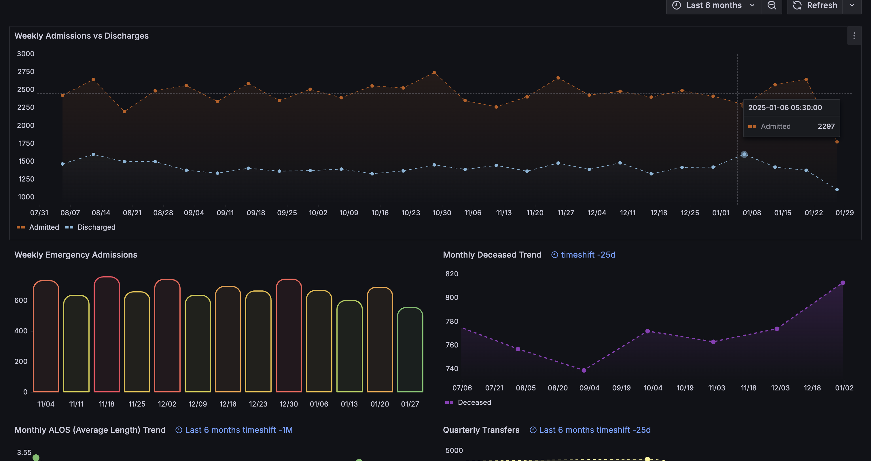
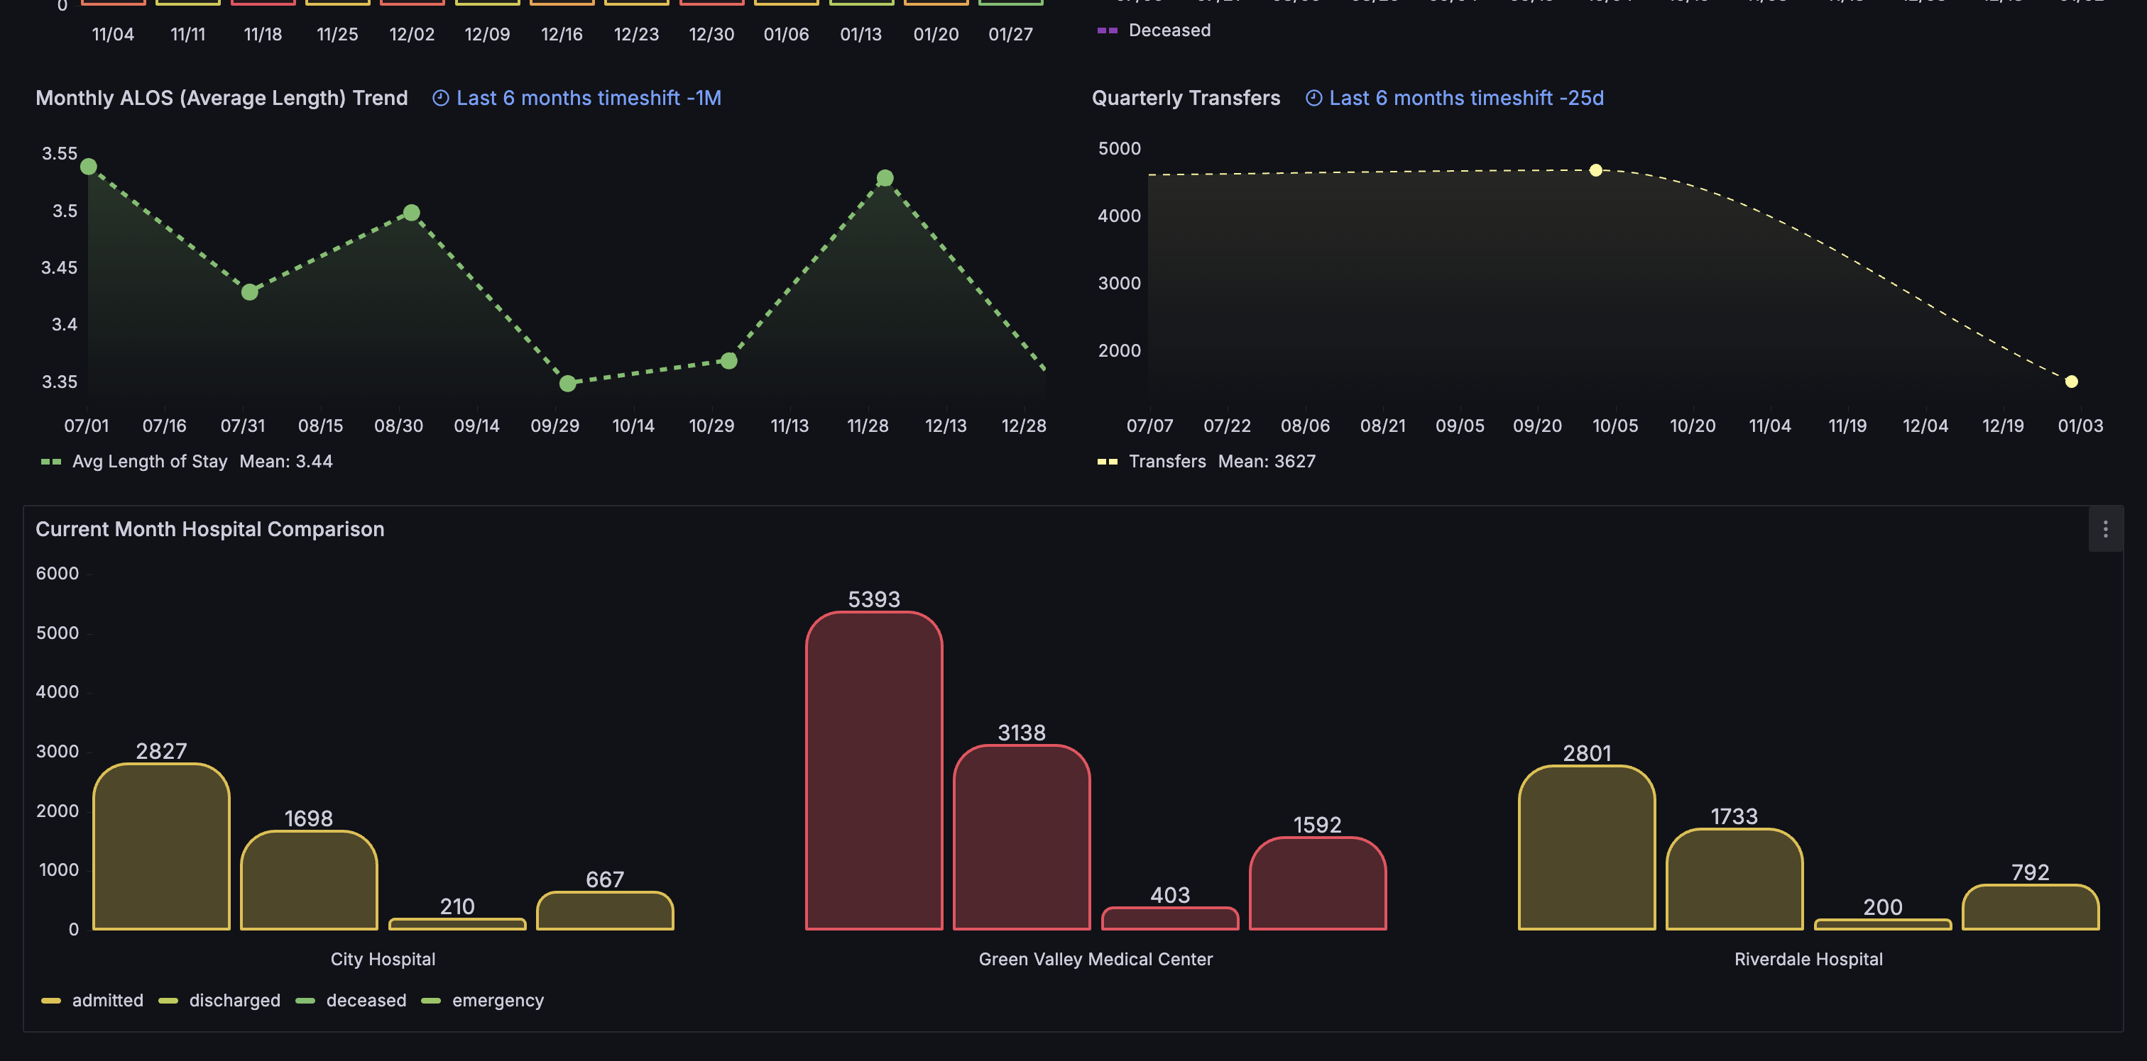
Dashboard 2 – Trend & Multi-Hospital Focus
Notes:
• Purpose: Explore longer-term patterns (weekly, monthly, quarterly) and compare hospitals side by side.
• Weekly Admissions vs Discharges: Multi-line chart to see capacity changes over time.
• Emergency Admissions: Weekly bar chart revealing potential surges.
• ALOS (Avg Length of Stay) Trend: Evaluate efficiency over months.
• Quarterly Transfers: Spot facility transfers to manage resources.
• Multi-Hospital Comparison: Current month stats for each hospital side by side.
Grafana Usage
• Line charts for weekly admissions/discharges: easy to see capacity fluctuations.
• Bar or stat panels for weekly emergency admissions.
• Time-shift features in Grafana (e.g., -1M, -25d) let us compare the same metric across different date ranges on one chart.
Value to Stakeholders
• Operations teams can spot if certain weeks consistently run higher on discharges vs admissions.
• Management can track the average length of stay (ALOS) monthly—important for resource planning.
• Hospital chain executives see how each facility is performing (admitted, discharged, emergency counts, etc.) to allocate budgets or shift resources.

Slide 5
• Purpose: Explore longer-term patterns (weekly, monthly, quarterly) and compare hospitals side by side.
• Weekly Admissions vs Discharges: Multi-line chart to see capacity changes over time.
• Emergency Admissions: Weekly bar chart revealing potential surges.
• ALOS (Avg Length of Stay) Trend: Evaluate efficiency over months.
• Quarterly Transfers: Spot facility transfers to manage resources.
• Multi-Hospital Comparison: Current month stats for each hospital side by side.
Grafana Usage
• Line charts for weekly admissions/discharges: easy to see capacity fluctuations.
• Bar or stat panels for weekly emergency admissions.
• Time-shift features in Grafana (e.g., -1M, -25d) let us compare the same metric across different date ranges on one chart.
Value to Stakeholders
• Operations teams can spot if certain weeks consistently run higher on discharges vs admissions.
• Management can track the average length of stay (ALOS) monthly—important for resource planning.
• Hospital chain executives see how each facility is performing (admitted, discharged, emergency counts, etc.) to allocate budgets or shift resources.

Slide 6
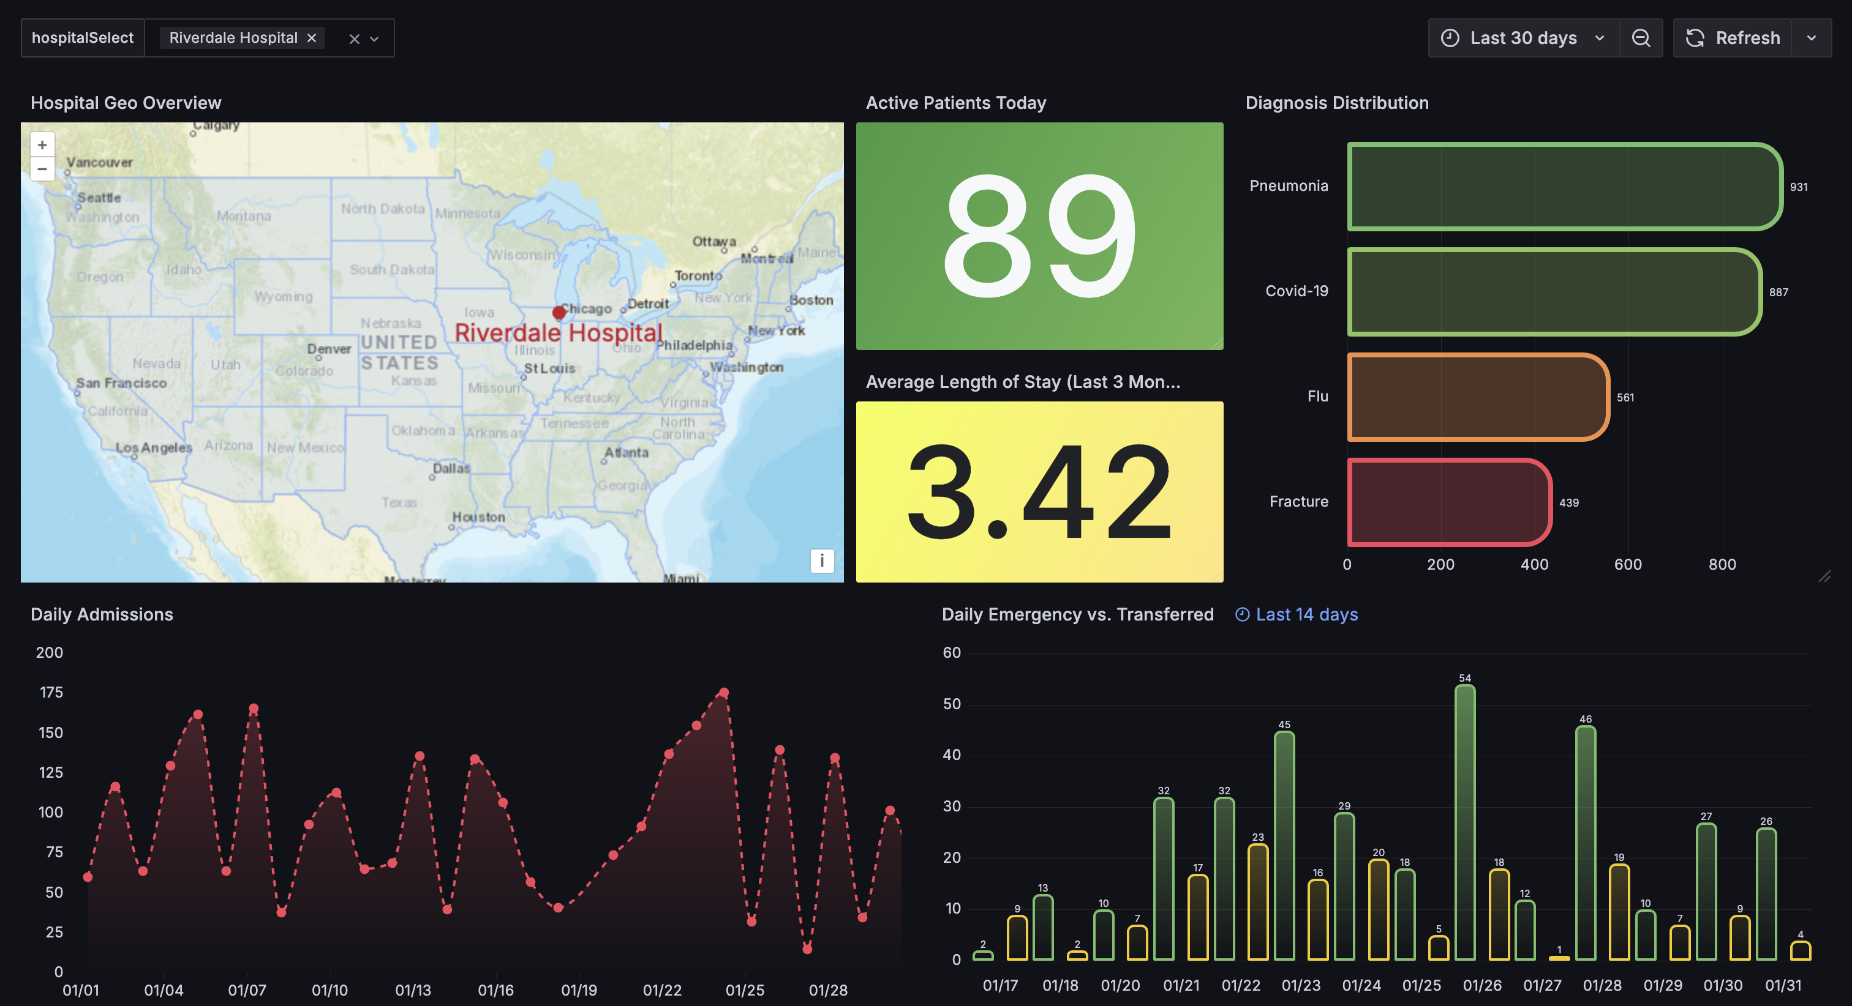
Dashboard 3 – Geo & Single-Hospital Focus
Notes:
Purpose: Combine a map view with real-time stats for one specific hospital at a time.
Hospital Geo Overview: Map panel to visualize location & real-time selection of hospital.
• Active Patients Today / ALOS: Single-stat tiles for quick snapshot.
• Diagnosis Distribution: Horizontal bar chart showing top diagnoses (pneumonia, Covid-19, etc.).
• Daily Metrics: Admissions line chart; Emergency vs. Transferred bar.
• Interactive: Switch hospitals via $hospitalSelect, updating the map & stats instantly.
Grafana Usage
• GeoMap panel: Markers show hospital location, metrics can be displayed in tooltips.
• Stat panels (Active Patients, ALOS) highlight key KPIs at a glance.
• Bar chart for diagnosis distribution: easily see top conditions (pneumonia, Covid-19, etc.).
• Daily trends (Emergency vs. Transferred) show short-term movement in critical metrics.
Value to Stakeholders
• Geospatial clarity: See exactly where a hospital is located and how it’s performing.
• Nursing/clinical leads can monitor daily admissions or changes in emergency load.
• Management quickly checks ALOS and active patients, helps plan staff or bed usage.
• Real-time selection: Switch hospital, instantly refresh stats and map—seamless for operational or regional directors overseeing multiple locations.

Slide 7
Purpose: Combine a map view with real-time stats for one specific hospital at a time.
Hospital Geo Overview: Map panel to visualize location & real-time selection of hospital.
• Active Patients Today / ALOS: Single-stat tiles for quick snapshot.
• Diagnosis Distribution: Horizontal bar chart showing top diagnoses (pneumonia, Covid-19, etc.).
• Daily Metrics: Admissions line chart; Emergency vs. Transferred bar.
• Interactive: Switch hospitals via $hospitalSelect, updating the map & stats instantly.
Grafana Usage
• GeoMap panel: Markers show hospital location, metrics can be displayed in tooltips.
• Stat panels (Active Patients, ALOS) highlight key KPIs at a glance.
• Bar chart for diagnosis distribution: easily see top conditions (pneumonia, Covid-19, etc.).
• Daily trends (Emergency vs. Transferred) show short-term movement in critical metrics.
Value to Stakeholders
• Geospatial clarity: See exactly where a hospital is located and how it’s performing.
• Nursing/clinical leads can monitor daily admissions or changes in emergency load.
• Management quickly checks ALOS and active patients, helps plan staff or bed usage.
• Real-time selection: Switch hospital, instantly refresh stats and map—seamless for operational or regional directors overseeing multiple locations.

Slide 8
Conclusion & Next Steps
Grafana’s Impact: Centralized, real-time hospital data
Stakeholder Benefits: Immediate insights, trend analysis, resource planning
Key Takeaways:
1. Short-term vs. long-term metrics
2. Multi-hospital & geo comparisons
3. Actionable visuals
Looking Ahead: Alerts, predictive analytics, deeper drill-downs
Notes:
Grafana’s Role
• Provided a unified platform to visualize daily, weekly, monthly metrics, all updating from PostgreSQL in real time.
• Flexible dashboards accommodate different panels (pie charts, time-series lines, geomaps) tailored to each stakeholder need.
• The hospitalSelect variable and time-range filters let users drill into specific facilities or dates, enabling quick, data-driven decisions.
Key Takeaways for Stakeholders
1. Immediate Operational Insight: Daily vs. yesterday panels help operations staff see patient inflows/outflows and respond to capacity spikes.
2. Longer-Term Strategy: Weekly, monthly, and quarterly views guide management in budget allocation, staffing schedules, and identifying recurring trends.
3. Comparisons & Geo Context: Executives can compare multiple hospitals or see location-based metrics to spot high-demand regions quickly.
4. Interactive & Scalable: Grafana’s dynamic panels and data sources can scale to include more hospitals, additional metrics, or advanced analytics.
Future Enhancements
• Alerts: Configure threshold-based notifications (e.g., if admissions exceed X).
• Predictive Analytics: Integrate ML forecasting (e.g., ARIMA or Prophet) for anticipating patient load.
• Increased Granularity: Drill down to ward-level or diagnosis-level detail, delivering deeper insights for clinical teams.
• Cross-Functional Integration: Merge financial, staffing, or inventory data to build a more comprehensive hospital performance suite.

